Slide 1





CYBERSHIELD AI
Next-Gen AI-Powered Cybersecurity Platform | Threat Detection | Vulnerability Triage | Policy Intelligence
TEAM NAME : Gryffindors
COLLEGE : A.P.SHAH Institute Of Technology , Thane (W)
MEMBERS : 1.Amitesh Jain
2.Darsh Jain
3.Riya Koli
4.Vaishnavi Khule
PS NUMBER : 2
6
SECURITY MODULES
70B
PARAM AI MODEL
251K+
CVEs TRACKED
LIVE
THREAT DETECTION

Slide 2
PROBLEM DEFINITION
Problem Statements:
CYBERATTACKS ARE INCREASING EXPONENTIALLY — Malware, phishing, and zero-day vulnerabilities cause billions in damages annually.
SECURITY TEAMS ARE OVERWHELMED— Manual threat analysis is slow, error-prone, and unable to scale with modern attack volume.
DEEPFAKE EPIDEMIC — Deepfakes and AI-generated phishing content are bypassing traditional detection tools.
HONEYPOT— Organizations lack real-time visibility into network intrusions, credential theft, and honeypot activity.
CVE TRIAGE IS A BOTTLENECK — Security teams waste hours manually prioritizing thousands of vulnerabilities.
Existing Problems:
No unified platform combining malware scanning, phishing detection, CVE analysis, and policy interpretation.
Traditional antivirus tools miss heuristic/polymorphic threats; no AI reasoning layer.
Policy documents are static PDFs — employees can't query them conversationally.
No accessible deception/honeypot tooling for small-to-mid organizations

Slide 3
PROPOSED SOLUTION
CyberShield AI — A Unified AI-Powered Cybersecurity Operations Platform.
01 MALWARE SANDBOX
02 PHISHING INTERCEPTOR
Upload any file; integrates VirusTotal API + SHA-256 hash caching for real-time polymorphic threat detection with confidence scoring.
Analyzes raw text, emails (.eml), images, and videos using LLaMA 3.3 70B (text/NLP) and LLaMA 3.2 90B Vision (deepfake detection via pixel artifact analysis).
03 CVE TRIAGE ENGINE
04 POLICY INTERROGATE
Fetches live NIST NVD data, scores CVEs using CVSS, then uses Groq AI to prioritize and generate actionable remediation steps
Upload any PDF security policy; ask natural language questions and get pinpoint answers grounded in the document..
05 HONEYPOT NETWORK
06 NEXUS AI COPILOT
Real-time simulated deception network showing live attack traffic, tar-pit responses, and credential harvesting logs.
Streaming security chatbot (Groq / LLaMA 3.3 70B) for incident response, firewall rules, CVE explanations, and hardening checklists.

Slide 4
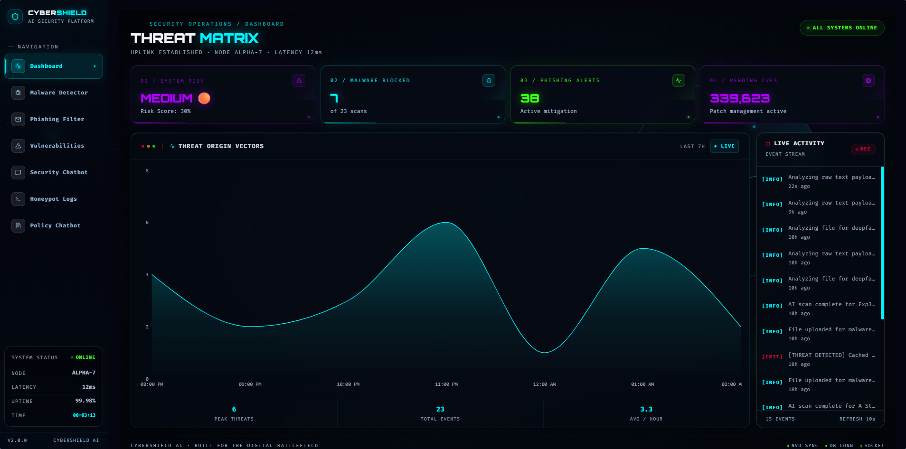
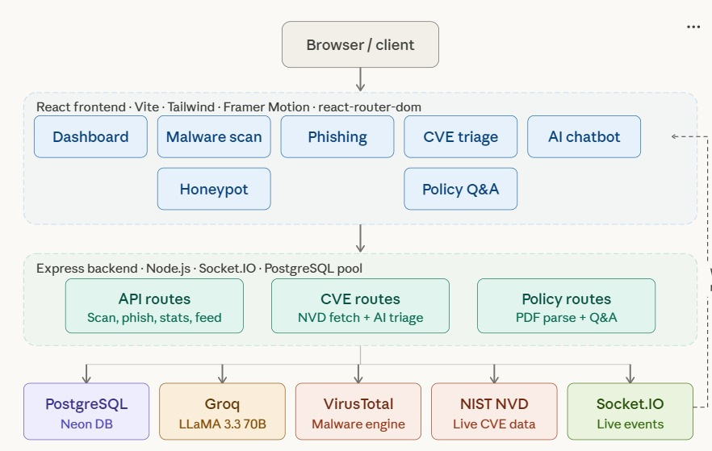
TECHNICAL APPROACH
TECH STACK:
Frontend — React 19, Vite 8, Tailwind CSS, Framer Motion, Rechart.js
Backend — Node.js, Express 5, Socket.IO
AI/LLM — Groq API (LLaMA 3.3 70B + LLaMA 3.2 90B Vision)
Security APIs — VirusTotal v3, NIST NVD
Database — PostgreSQL (Neon)
PDF Parsing — pdfreader / pdf-parse
Ctrl + Click
Prototype
Github Repo - https://github.com/vaishnavikhule1405-bit/CyberShieldAI
ARCHITECTURE OVERVIEW
ARCHITECTURE DIAGRAM

Slide 5
CONCLUSION & IMPACT
FUTURE SCOPE
SIEM integration — Splunk
Autonomous threat response systems.
Cloud-native & mobile monitoring.
Predictive threat intelligence.
PROBLEM SUMMARY
Rising cyberattacks: malware, phishing, deepfakes, CVEs .
Manual analysis → slow, error-prone, not scalable.
No unified platform; tools are fragmented.
Lack of real-time visibility & AI-driven detection.
RESEARCH & REPORTS
Transformer & NLP security models (BERT, GANs)
National Institute of Standards and Technology (NIST CSF)
Cybersecurity and Infrastructure Security Agency (CISA)
National Vulnerability Database (CVE data)
SOLUTION IMPACT
Unified AI platform for detection, analysis & response.
Faster threat detection & automated CVE prioritization.
Improved accuracy using LLaMA models.
Real-time monitoring + intelligent decision support.
DOCUMENTAION:
React, Node.js, Express.js
PostgreSQL / Neon
VirusTotal, Groq APIs

